Slide 1

IRONHACK DATA ANALYTICS MID BOOTCAMP PROJECT
CHIDUBEM EZENWAFOR

Slide 2

WOOD PRODUCTS
Introduction
Data was obtained from https://unece.org/forests/data-forest-products-production-and-trade#accordion_0
Contains trade and harvest data from 1964-2021
Primary goals
-observe raw material export
#observe competitions between selected raw materials and woodfuel
-analyse Balance of trade
- analyse value for unit products exported
- analyse harvest to export ratio to determine how much local industry consumption and with more data explore wastage
-observe engineering board production

Slide 3
CHALLENGES
Lots of missing Data with 0 values and empty cells
Lots of Data belonged to defunct states
lots of products and some are no longer in production
flow column which consist of removal, import, exports and production, have one or two of the above missing for a number of countries for a particular year
SOLUTION
Spent 3 out of the 4 days project period cleaning and wranglingdata
chose recent period 2007-2021 for analysis
replaced empty cells with 0, and dropped Nan majority in cases where it is the majority, with no value in the time frame we were interested in(2007-2021)
Melted table for ease in accessing flow and year data

Slide 4
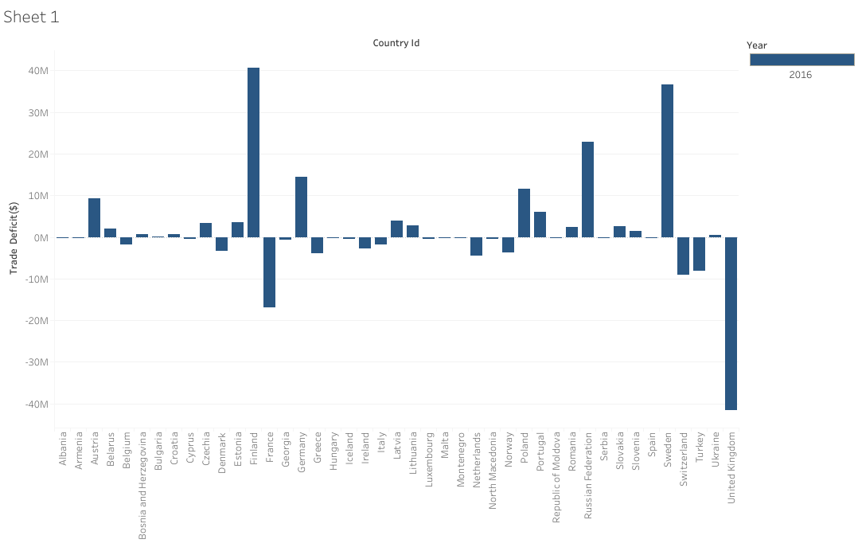
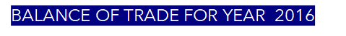
OBSERVATION
The united kingdom had a huge trade deficit for fiscal year 2016, while sweden and finland had the biggest positive balance of trade.

Slide 5
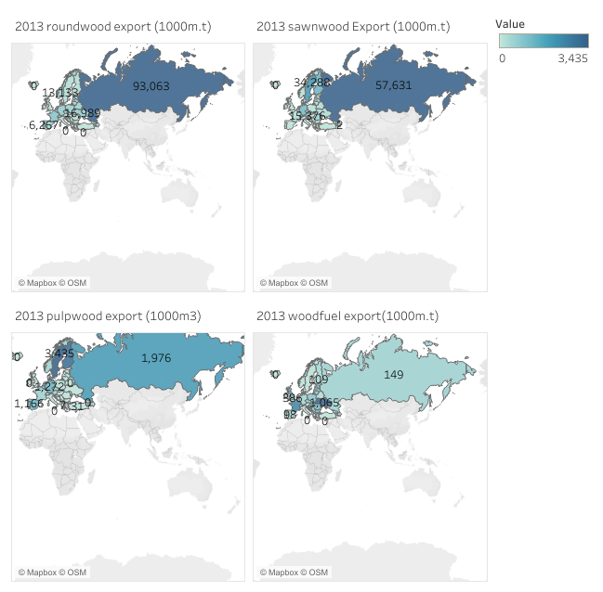
BIGGEST EXPORTERS OF SELECTED RAW MATERIALS AND WOODFUEL
SELECTED RAW MATERIALS
Roundwood
Sawnwood
Pulpwood

Slide 6
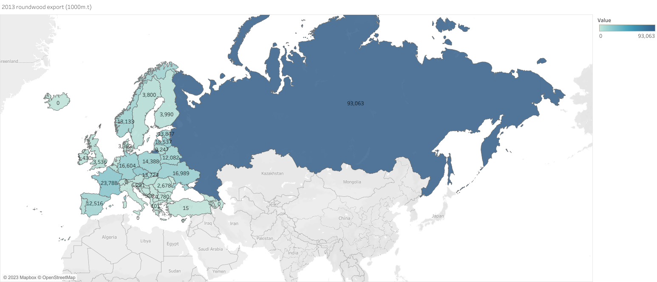
ROUNDWOOD EXPORT 2013

Slide 7
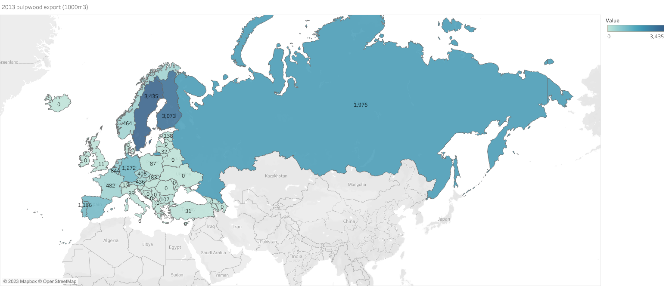
Pulpwood Export 2013

Slide 8
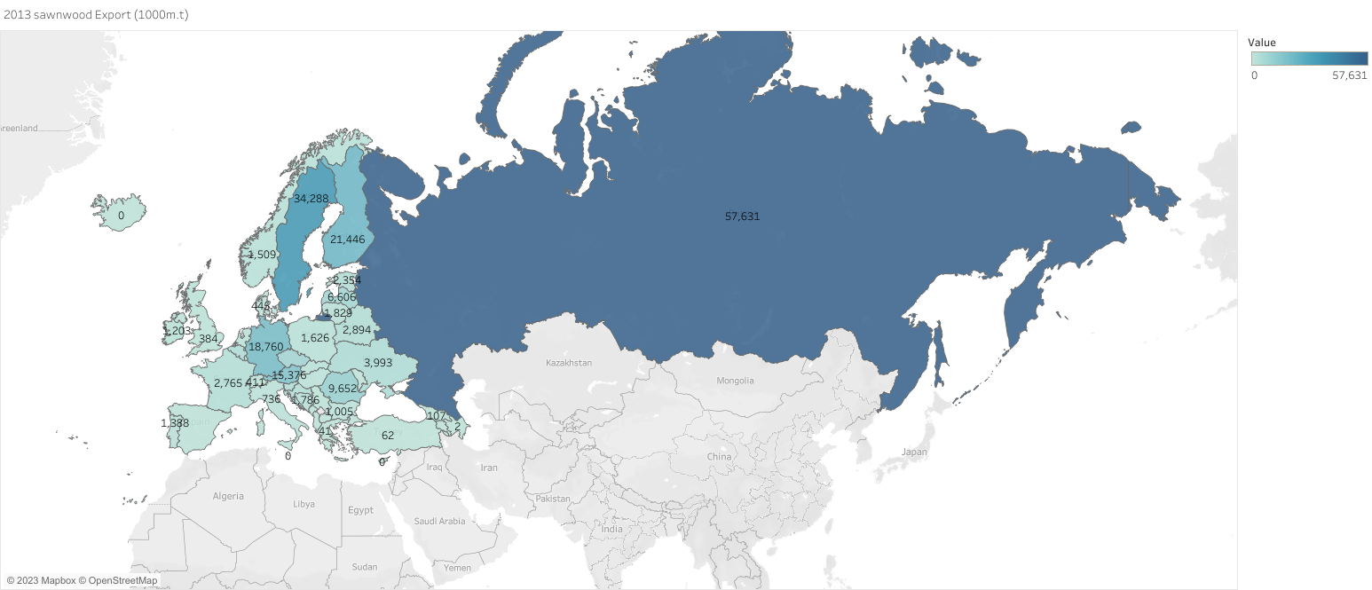
SAWNWOOD EXPORT 2013

Slide 9
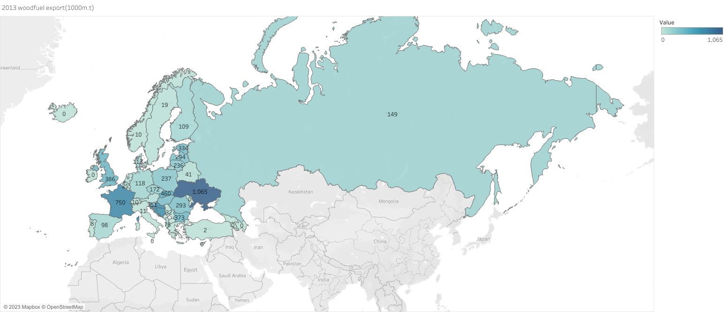
WOODFUEL EXPORT 2013

Slide 10
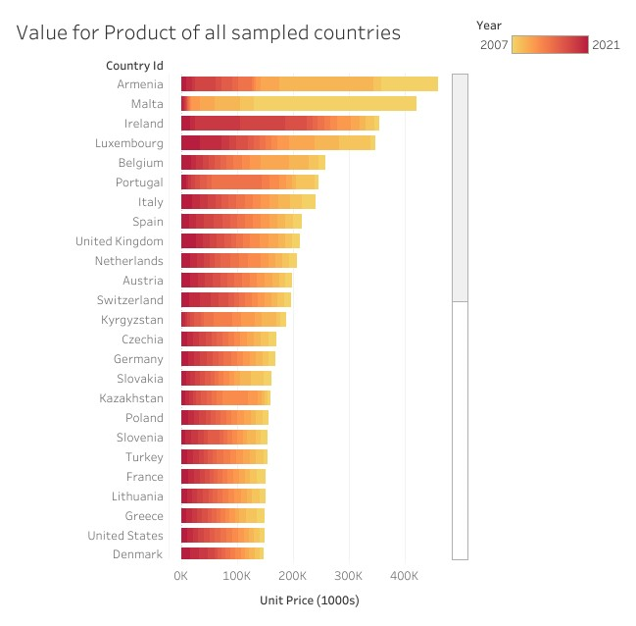
COMPARING VOLUME AND VALUE OF PRODUCTS
OBSERVATIONS
Some states recieved much value for their product in some specific years and performed poorly in the other years
Malta and Ireland has some interesting information that will be useful in future research

Slide 11
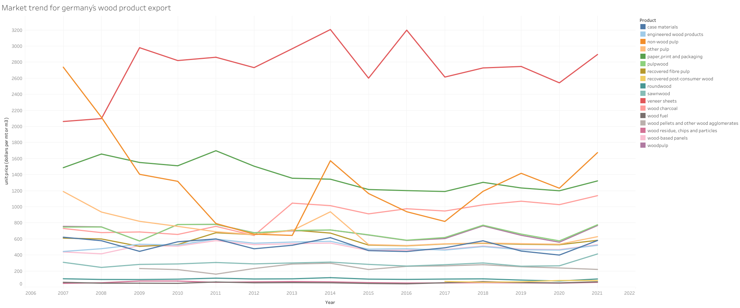
Price Trend of German exports from 2007-2021
OBSERVATION
Our selected raw materials are more less stable in their price value over the years

Slide 12
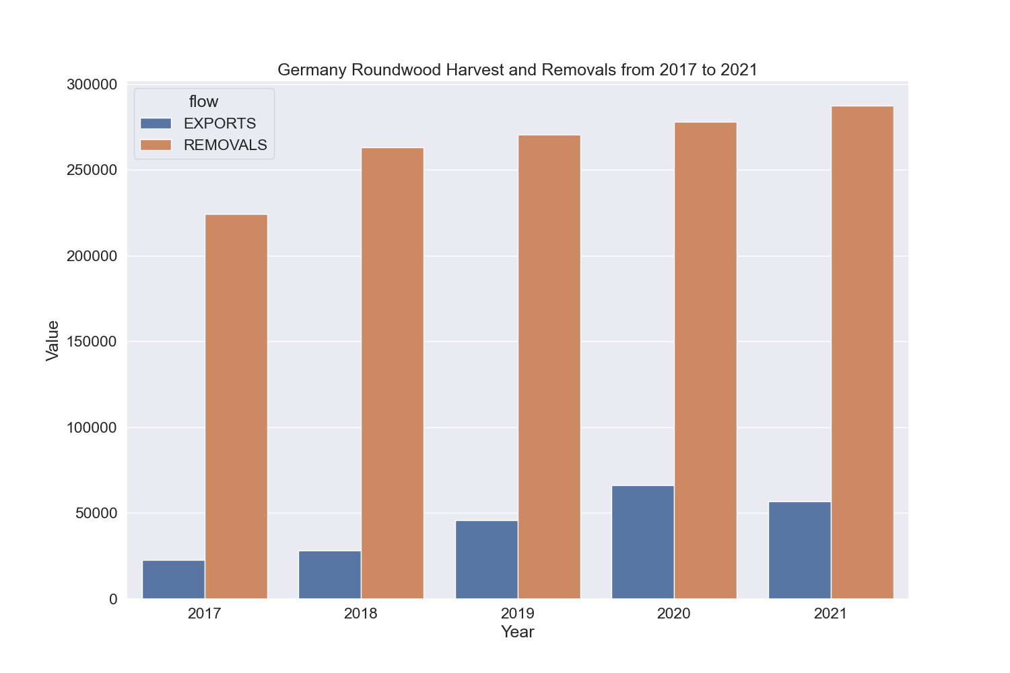
Harvest to Export Ratio *Useful to explain raw material use by local industry
OBSERVATION
German export is a low percentage of her removal or total harvest, this could be attributed to a strong local industry BUT wastage wasn´t factored in, especially considering german forest health

Slide 13

Engineering board Production in Europe

Slide 14

CONCLUSION
The analysis reveals a lot of gap in both historic and mordern data with regards to european forestry
Much effort should be concentrated on proper data gathering , especially given rising threat from global warming and illegal deforestation
Wood based industries will also benefit from having more data available and properly analyzed to inform their decisions
Wastage data should be meticulously tracked for proper management and policý changes to address them

Slide 15
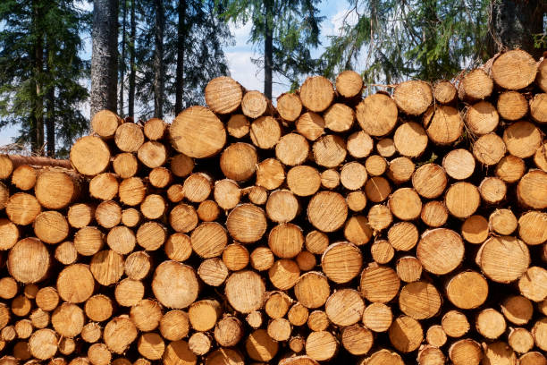
THANKS FOR YOUR ATTENTION
THE END

